Slide 1
Making R Graphs
© McGraw Hill LLC. All rights reserved. No reproduction or distribution without the prior written consent of McGraw Hill LLC.

Slide 2
Excel Data
We have 44 observations on price-earnings ratios for a sample of S&P 500 companies. We want to describe the shape of the distribution. First, we import the data to R.
Row-Column Format
One Column
Note: Row-column format is OK in Excel, but not good for import. R would interpret each column as a separate variable and would not know what to do with the heading. We reformat Excel data into a single column with a simple heading.
middle rows omitted

Slide 3

Import Data
A quick way to import data to R is the clipboard. Highlight the data block in Excel (including its column heading) and copy it to the clipboard using Ctrl+c (Windows) or command+c (MacOS). We will call the imported data PEData. For Windows, enter:
> PEData = read.table(file="clipboard", sep="\t", header=TRUE)
For MacOS, enter:
> PEData = read.table(pipe("pbpaste", sep="\t", header=TRUE)
The argument sep="\t" tells R that the columns are tab-separated. The argument header=TRUE tells R to expect text headings on each column.
Tip1: R doe not want column names that begin with a number or contain special symbols like % and $.
Tip2: An advantage of the clipboard method is that you choose exactly what to import.

Slide 4
View the Data
As we requested, R stores the imported data in an object named PEData. To view the data (44 observations) type the name of the object.
> PEData
PERatio
1 59
2 16
20
...
42 9
43 37
44 13
After verifying that the imported data look OK, we are ready to request detailed statistics and/or graphs.
Note: Middle values omitted for brevity.

Slide 5
Import Data
Use the summary(x) function to view statistics for PEData and stem(x) for a stem-and-leaf plot. In stem(x) the variable name PERatio is preceded $ because PEData could have more data columns (it doesn't in this example).
> summary(PEData)
PERatio
Min. : 7.00
1st Qu.:13.00
Median :17.50
Mean :20.61
3rd Qu.:24.50
Max. :59.00
> stem(PEData$PERatio)
The decimal point is 1 digit(s) to the right of the |
0 | 79
1 | 000011123334456666778899
2 | 00112346678
3 | 1778
4 | 2
5 | 09
Note: Possibly skewed right because mean exceeds median.
Note: Long upper tail suggests positive skewness. Possible high extremes?
Note: Stem-and-leaf displays work best for integer data.

Slide 6
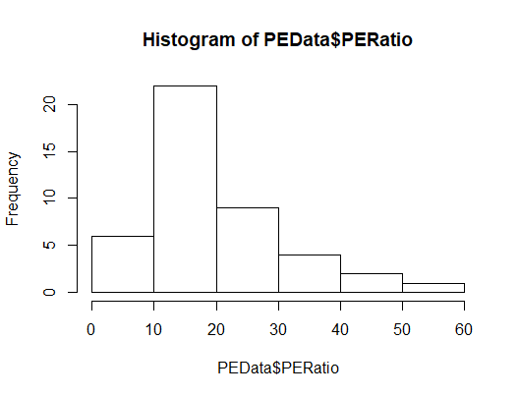
Histogram
Request a histogram for a vector x using the hist(x) function. The histogram appears in the lower right Files pane. It can be copied to the clipboard or exported to a file:
> hist(PEData$PERatio)
Note: Upper tail is longer, which indicates positive skewness.
Note: We omitted all optional arguments for the hist() function so we got the default number of bins, based on Sturges' Rule (6 bins, 7 axis break points).

Slide 7
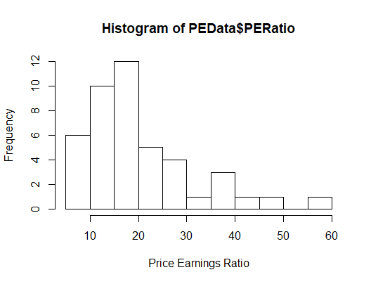
Histogram
You can include an optional argument breaks=k to force k-1 bins. To choose your own axis label you can include an optional xlab argument:
> hist(PEData$PE.pE.RatioRatio,xlab="Price Earnings Ratio", breaks=12)
For example, we requested 11 bins (12 axis breaks) and axis label “Price Earnings Ratio”.

Slide 8
Scatter Plots
We have paired observations on acceleration times (in seconds) for 39 vehicles:
middle rows omitted
Highlight our two Excel data columns (including column headings), copy them to the clipboard using Ctrl-c (Windows) or command+c (MacOS) and paste the data into an R data frame named Accel:
> Accel=read.table(file="clipboard", sep=”\t”, header=TRUE)

Slide 9
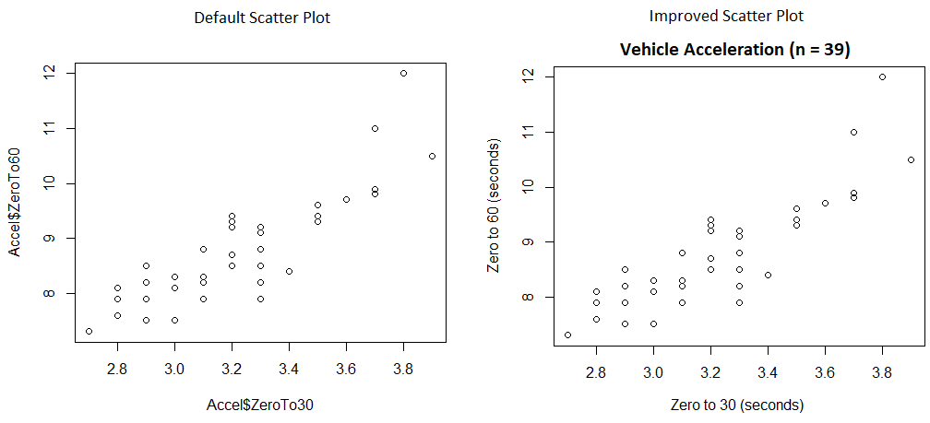
Scatter Plots
Make a scatter plot using the function plot(x, y):
> plot(Accel$ZeroTo30,Accel$ZeroTo60)
We can create better axis labels using optional arguments xlab and ylab and main to add a title.
> plot(Accel$ZeroTo30, Accel$ZeroTo60, xlab="Zero to 30 (seconds)",
+ ylab="Zero to 60 (seconds)", main="Vehicle Acceleration (n = 39)")

Slide 10

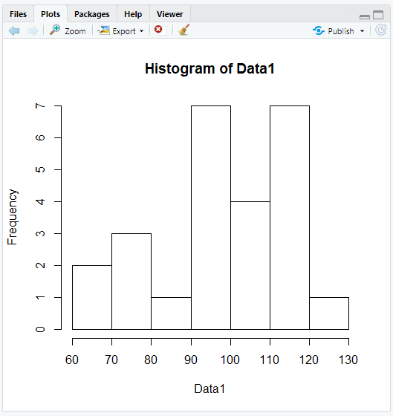
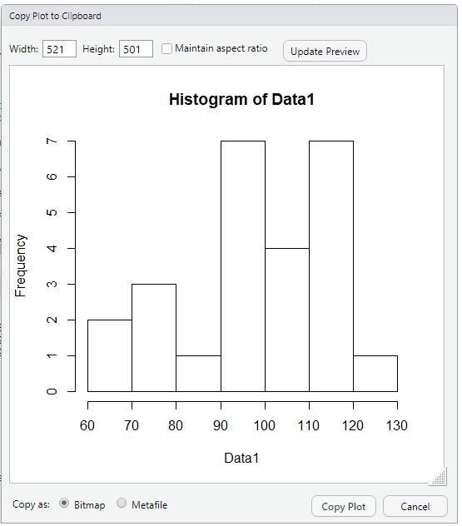
Export a Plot

Slide 11
Normal Plot
When a histogram does not tell you enough about the shape of a distribution, we can make a q-q plot ("quantile-quantile" plot) to compare the sample with, say, a normal distribution. A near-linear q-q plot suggests that the data resemble the specified distribution.
Row-Column Format
One Column
Note: For safe import, reformat Excel data into a single column with a simple heading.
Note: Data show the "current ratio" for 75 small manufacturing firms, a measure of liquidity defined as (current assets)/(current liabilities). If this ratio is below 1, the firm does not have enough assets to meet its liabilities and is insolvent. A ratio of 1.5 to 2 is generally desirable, while a ratio of more than 2 could mean that the firm has too much tied up in non-earning assets.

Slide 12
Verify Data
We import the data to a data frame named CurrData. To view the data, type the name of the object (middle values omitted for brevity).
> CurrData
Current.Ratio
1 2.04
2 1.33
1.03
...
73 1.48
74 1.65
0.70
After verifying that the imported data look OK, we are ready to request detailed statistics and/or graphs.
Note: We had a space in the Excel column title "Current Ratio." R converted the space to a period.

Slide 13
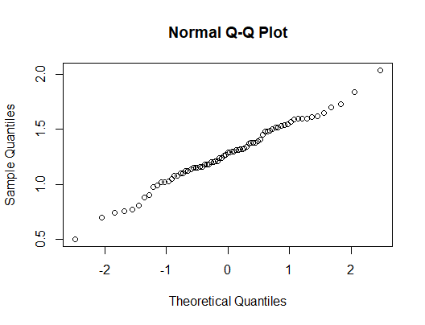
Normal Plot
We request an overview of the data using the summary() function. The mean and median are similar, suggesting symmetry. Next, we request a qq-plot to compare the data with a normal distribution. The qq plot is nearly linear, suggesting a good fit.
> summary(CurrData)
Current.Ratio
Min. :0.500
1st Qu.:1.120
Median :1.290
Mean :1.275
3rd Qu.:1.485
Max. :2.040
> qqnorm(CurrData$Current.Ratio)
Tip: Testing for normality is important in many statistical tests. Excel does not offer a q-q plot.

Slide 14

Advice
Excel charts ...
Pro: easy to create, customize, and apply templates
Pro: familiar in business world and easy to share
Con: histograms have weird bins, non-aligned axis ticks
R plots ...
Pro: are quick and acceptable with only defaults
Pro: have proper axis ticks and easy to export
Con: tricky to customize and require R experience
Alternatives ... Minitab? JMP?

